Slide 1
Terraform for Java Developers

Slide 2
Terraform for Java Developers
Beginner level introduction to Terraform development, intended for Java/Spring developers.
This course is NOT a course on how to deploy Java into AWS, but a way to translate the terms of java, and OOP, into Terraform.
Expectations of this course
What is Terraform?
Why do we use Terraform? Aren’t there better solutions?
How can you compare to completely different programming paradigms
Terraform Concepts and how they relate to Java/Spring development

Slide 3
Terraform for Java Developers
Expectations
At the end of this course, you will have been exposed to the concepts of Terraform, with a reflection on how they relate to OOP in general, and Java/Spring in particular.
You will be walked through the deployment of a simple set of resources in AWS.
You will see how the various resources within Terraform can interact with each other, and how you can keep secrets… secret.
You will have been exposed to different ways to set, retrieve, and calculate values necessary in the deployment.
As we go through this today, please use the chat-box to ask questions and include the slide-number. I may not answer the questions as you ask them, but they may be answered in later slides. If not, we can go back to the slide at the end to ensure that your questions are answered.
This feedback will be greatly appreciated as I refine this deck, and possibly include a comment about your questions in the final deck.

Slide 4



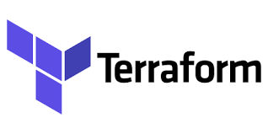

Terraform for Java Developers
What is Terraform
Infrastructure as Code – Provisioning and managing computer (cloud) resources via definition files
Terraform as IaC – Stateful, declarative configuration language used to define resources as they are expected to exist.
AWS Cloud
AWS Cloud
resource aws_vpc tjd_vpc {
cidr_block = “10.0.0.0/16”
}
VPC
10.0.0.0/16
terraform apply
Notes:
TF is written in Go, and is therefore cross-platform compatible.
It is open-source, with lots of resources created and/or enhanced by a large public userbase.
As a stateful language, you describe how you want your infrastructure, aka Cloud Resources, to look. It compares the existing state to the desired state and makes the changes as required.
Certain changes may be made in-place, such as simple updates. Others require replacement.
Simple changes, often such as tag updates
Replacement changes, often scale-up/down, or key aspects of the resource – CIDR Range, RDS Engine, EC2 instance type, KMS changes, etc

Slide 5
Terraform for Java Developers
Why do we use Terraform?
As a programmatic description of the desired state, terraform can be repeated in multiple different areas.
Automatable via pipelines for deployment, or CLI
Configurable via variables
Terraform works for multiple clouds, as well as K8S, MongoDB-Atlas, ActiveDirectory, and VMWare
AWS Cloud
AWS Cloud
terraform apply
resource aws_vpc tjd_vpc {
cidr_block = “10.0.0.0/16”
}
VPC
10.0.0.0/16
AWS Cloud
AWS Cloud
VPC
10.0.0.0/16
terraform destroy
resource aws_vpc tjd_vpc {
cidr_block = “10.0.0.0/16”
}
Notes:
As a descriptor of our desired state, Terraform can be deployed many times in multiple different regions and/or environments. It can also be re-used via modules (we’ll touch on those later) to create pre-configured, pre-vetted secure infrastructure.
It can be automated via various pipelines, such as Jenkins, CodeDeploy, Azure DevOps Pipeline and just about every other deployment tool available.
We can configure it with variables and different backends so that the different deployments can best reflect the exact use.

Slide 6
Terraform for Java Developers
Java Concepts in Terraform
Java Package-> all .tf files in the directory being deployed from
Properties
variables -> required properties with data-types, descriptions, defaults, and validation requirements
tfvars -> implementation of the variables file with values that over-ride defaults and can be changed per deployment
backend.config -> more properties used to store state and locks
POM Configuration -> terraform block
Third-party libraries -> Providers
Class-constructors -> resources
Reusable code libraries -> modules
Class-methods -> data sources that can retrieve information for already-deployed resources
functions -> locals that are internally computed data, similar to variables
Please write your questions down and ask when we dive deeper into the above concepts. They may be answered in the next many pages.

Slide 7
Terraform for Java Developers
Walkthrough by topic
Demonstrate packages, the types of files (.tf, .tfvars, .tmpl, .json, etc)
All .tf are automatically included in the plan/apply/destroy
Targets are allowed
Changes may be ~ or +/-
Files can be imported (tmpl/json)
Demonstrate properties filesusers
Allows automation via most automation tools/pipelines, just requires tf be installed
Environmental impact (multi-region deployment, multi-environment deployment, etc)
variables.tf (Defaults, descriptions, validations, data-types)
.tfvars (multiple allowed, but not duplicate values)
backend.config (what it means, and when it’s used)
Demonstrate POM-type file (terraform block, etc)
Third-party libraries (providers, multiple providers, versioning requirements, etc)
Class constructors (resources, using multiple of a single resource, available resources, outputs)
Reusable libraries (modules, sources for modules)
Class methods (outputs from resources)
Functions (data sources and locals)

Slide 8
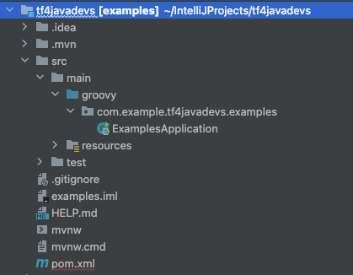
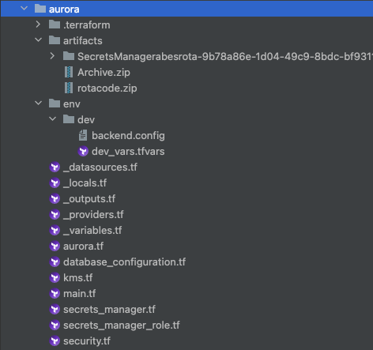
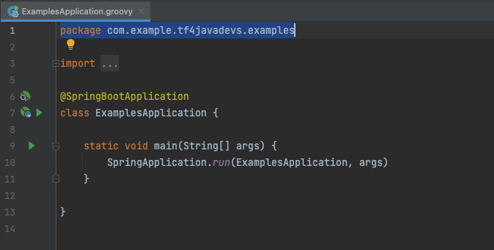
Packages…
Notes:
In the groovy app, you specify the name of the package in each file. In TF, you don’t need to.
All .tf files in the directory are automatically in the package.
There are multiple different types of files that you might have in this directory, such as json/xml files, template files, .tfvars files, or anything else. Only the .tf files are automatically included in the ’build’ (which is the wrong term, but we’ll visit that later!)
.tf files can be empty. This is great if you’re attempting to pre-plan your application. It’s also great if you’re trying to build custom terraform rep—templates, where you can prepopulate some of your ’standard’ files, automate some of your file naming standards, and the like.
Other folders can be referenced, such as the artifacts folder and the environment folders above.
Artifacts folder as shown is one way of many to upload code into AWS.
Resources can also obtain code from code-repos such as artifactory, git, etc for deployment

Slide 9
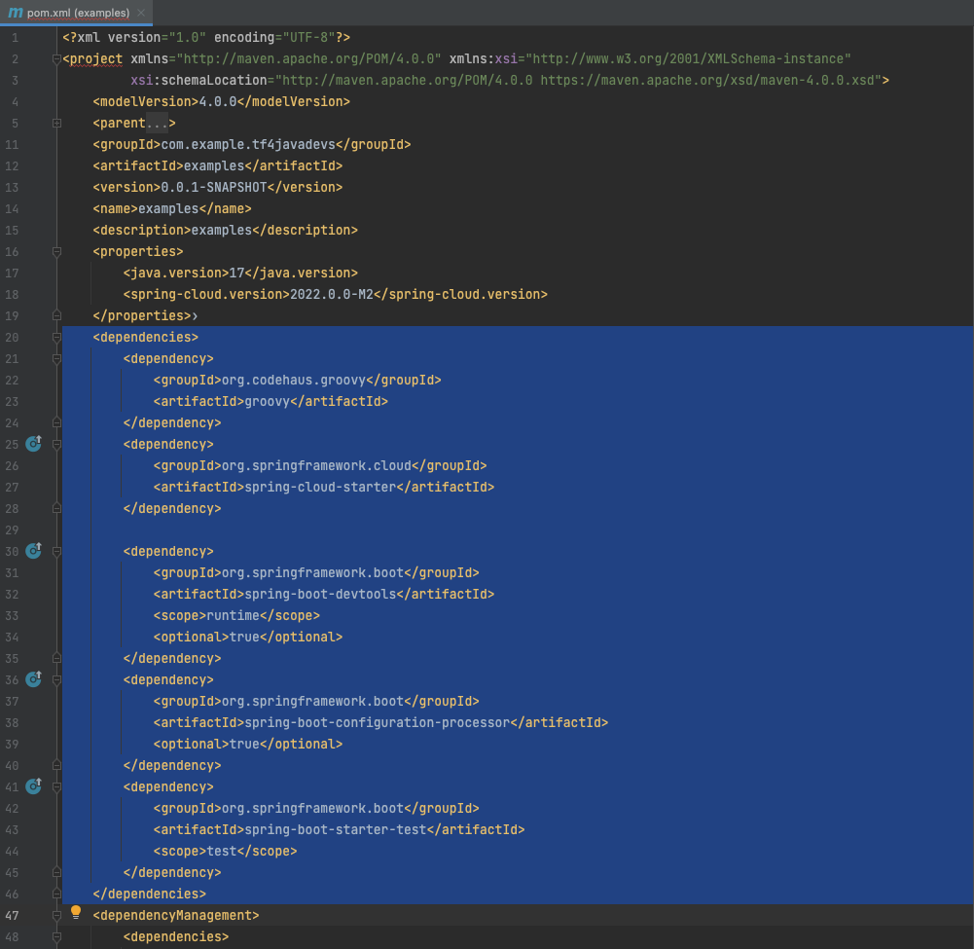
Package Resources and dependencies…
Notes:
In Groovy, you have a pom.xml file. This lists a variety of dependencies, from spring frameworks, open-source libraries, custom libraries, testing… you get the picture.
You can specify a variety of things in here, such as versions, so that a newly released version won’t break your application, or even the version of your application. You can even specify which repositories you want to pull from.

Slide 10
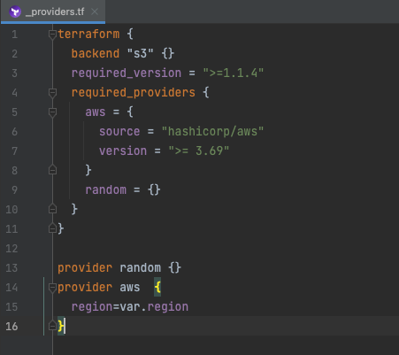
Package Resources and dependencies…
Notes:
In terraform, your package configuration file is relatively simple. You specify the provider(s), and that you’re using terraform.
In the terraform block, you see a specified backend, required terraform version, and all of the required providers for this runtime.
The backend attribute tells terraform where to store my infrastructure’s state-file. We’ll cover that next.
We’re going to cover the required provider block, as well as the providers, later on.

Slide 11
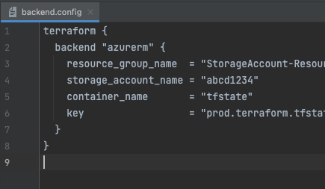
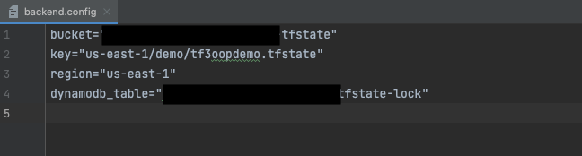
Configurations…
Notes:
Using Java or most other OOP languages, you can store a level of application properties either in the file, or in a central repository. This might include paths to certificates, connection strings to various databases, queues, or apis.
In Terraform, we also store our configuration files separately. As mentioned before, the Terraform block specifies a s3 backend. When we build our plan, we tell it where to look for the backend configuration file and it reads it in. In this example, you see that I’m specifying an S3 bucket and key, a region, and a dynamodb table.
Terraform is a stateful tool, and the backend is where it stores that state. A potential hazard comes up if you have multiple teams working on the same project and trying to deploy resources. The backend.config file has that dynamodb_table entry to store a locking file. This locking file ensures that only one person can control the backend state at one time. In this example, that region specifies which aws region holds the state. This allows me to maintain a single bucket in aws to hold the state files regardless of where I actually deploy the resources.
There’s an example as well of an Azure backend. You can deploy your cloud resources into one environment, while putting your backend into another one; such as deploying resources into AWS while storing your state files in Azure. All you have to do is ensure you have access to both.
Other backends can include azure, Google Cloud Storage, local storage, artifactory, etcd for the kubernetes fans out there, plus terraform’s own enterprise-supported cloud backend. There are others shown in the documentation as well.
So, this is just for the stateful configuration. We can also manage configuration for multiple different stages and environments…

Slide 12
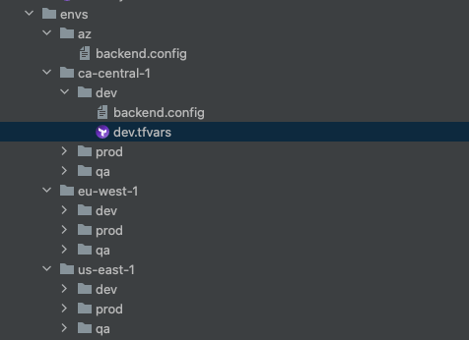
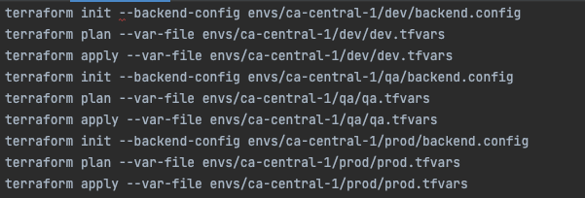
Configurations…
Notes:
On of the powers of using Infrastructure as Code tools is the ability to define all aspects of your application via a specific set of variables.
I mentioned automation earlier as one of the reasons to use IaC tools. This shows a folder of all of the regions and environments that this code is designed to be deployed to.
We can start by deploying to our “primary” region in dev and qa. We can test that there, and since all of our production is deployed via the exact same tool, there should be no surprised when this is deployed to all of the various regions and environments. Of course, that means we need to account for ‘drift’, but since we don’t allow, or shouldn’t allow, production environments to be manually manipulated in terms of deployed resources, there will hopefully be no drift, right? RIGHT?!?
We’ll initialize, plan and apply our code using similar commands, just changing the directories. I’ll explain these commands later.

Slide 13
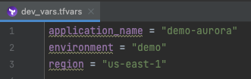
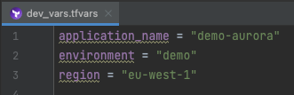
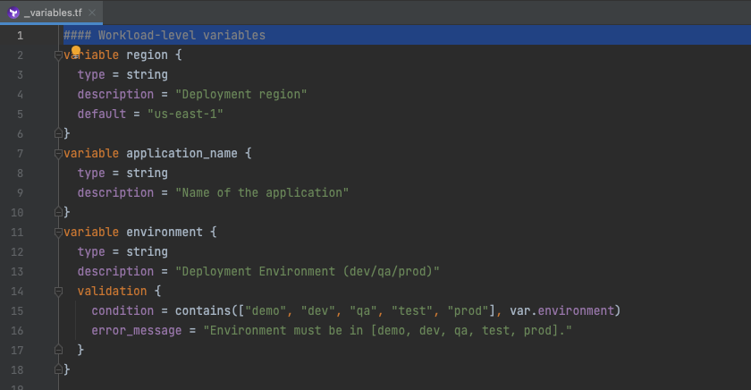

Configurations…
Notes:
I showed what the backend-config file means. And that has to be done for each deployment. This holds the state for each individual deployment, so we manage that per deployment environment/region.
But what about that tf.vars file? Those are variables, that refer to defined variables within our package. We saw our package earlier, and in there in a naming convention that I prefer is an under-bar-variables.tf file. I typically use the underbar as an indication that this is a package wide configuration tool, and you see the outputs, providers, locals, datasources and… variables…
Within this variables file, we set required parameters that each of the deployed environments will require.
Each one has a type and a description. Optionally, we can set a default and a set of validation requirements. In here, you see that my region is defaulted to us-east-1, and my environment is limited to a list of 5; demo, dev, qa, test, and prod.
I can pass in multiple different var-files when I plan/apply my terraform, so if I have a set of common variables such as application name or resource tags, I only have to set them in a single place. But I can also put them all in each var-file.
You also notice that I override my default region merely by setting it in the tfvars. file. If I run a apply a deployment and forget to set the region within the tfvars file the default will take over.

Slide 14
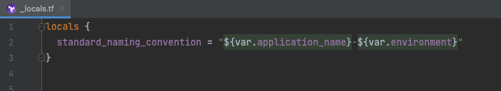
Configurations…
Notes:
Sometimes we create a set of variables, and then find excessive use of a pattern of variables. For instance, when I name my resources, and I want that “Name” to be a combination of application name, environment, and maybe a region, I can type those in individually as I create, in this case, a subnet group that has a name that directly refers to the application/environment. But what if I have multiple different resources I want to include in this way? Maybe I don’t want to keep doing that, because maybe I’ll mess up and put them in reverse, or an extra dash, or… any other error.
The DRY principle, Don’t Repeat Yourself, comes into play here, in that I can actually assign a local value that calculates my name. I can reuse this anywhere required.

Slide 15
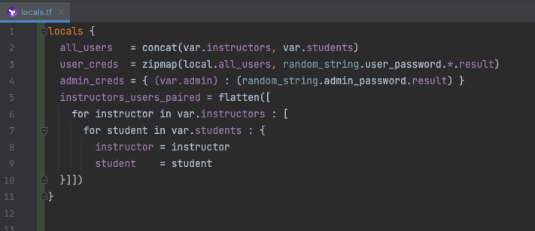
Configurations…
Notes:
But locals can actually do quite a bit more than that.
In a different script than this, I set up an AWS RDS instance that has multiple instructors and multiple students. Each student gets a database within the instance and they only have access to their instance.
Each instructor also gets their own instance, but they get access to ALL of the student instances so that they can log in and help.
In order to do that, I take lists of the students and instructors, and map them and flatten them into a list that has a every instructor paired with ever student. I loop through that in a resource to assign permissions on each student database.

Slide 16
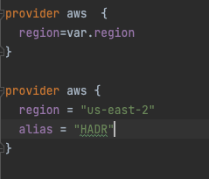

Libraries…
Notes:
Way back when, we looked at this Terraform block, and we briefly touched on the “required providers” block.
Providers are like third-party libraries. Many of these are open-source, and the community will often work to help add new features as providers release new features.
In the required_provider block, you see a version listed. By pegging the provider at a specific version, it ensures that anyone that deploys it is using the same version. Similar to a pom file that lists a version for a dependency.
The block also displays the source, in this case we’re using hashicorp (the parent of terraform)’s AWS provider.
In the aws provider, you see a region specified. This tells terraform that your deployment will be to the specified region. In this case, I’ve used a variable to assign the region. By using that variable, I can easily deploy this one terraform package to multiple different regions simply by passing in different value for the region variable at build time.
We can also instantiate multiple different aws providers, such as for a high-availability or disaster-recovery scenario. When we do that, we need to ensure that they’re differentiated, and we do that with aliases.

Slide 17
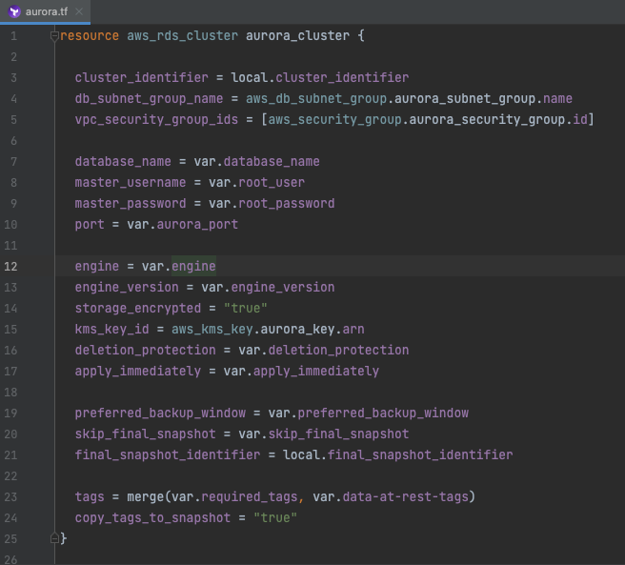
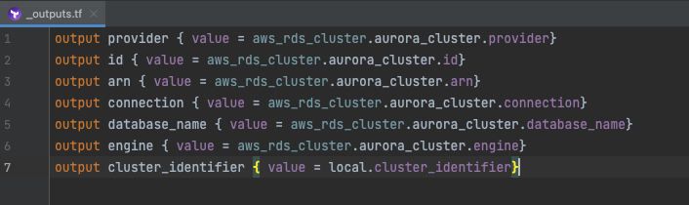
Classes…
Notes:
So now we can down to the classes in object-oriented-programming…
In Terraform, these are referred to as resources. Much like a class, we need a constructor. We do that as shown. Notice we’re passing in a lot of parameters into here, and nearly all of them are configurable via the variables.
From here, terraform will determine how to build it using the standard AWS CLI to deploy and wait for the completion of, the resources.
Additionally, each class, or resource in terraform, can have a set of outputs. These outputs allow us to refer to what we’ve already deployed and are standard for each resource. They won’t automatically output when you run them, but they are there to refer to. You see this in line 15, where I call for the arn from a aws_kms_key that I created elsewhere.
Using a directed acyclic graph, terraform realizes that I need to create the aws_kms_key named aurora key before I can create this aws_rds_cluster. Once the aurora key is created, we’ll refer to the arn, or Amazon Resource Name, when we create the cluster.
Each resource will have a variety of different potential outputs, and you’d have to look in the documentation to see what is available for each resource.
As you can see, we can also output these to the standard output when we deploy. We can output variables, locals, or outputs from classes. What we cannot do is output anything flagged as “sensitive” such as passwords.

Slide 18
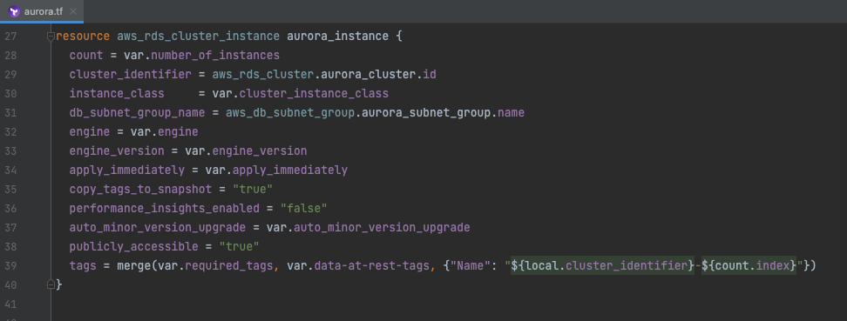
Classes…
Notes:
Sometimes we need to create multiples… In this case, what good is a cluster that has only a single cluster instance.
Here, simply by using a count, we create multiple instances.
Notice on line 39 we actually reference the index number from that count, so that each instance has its own name based on the index.

Slide 19
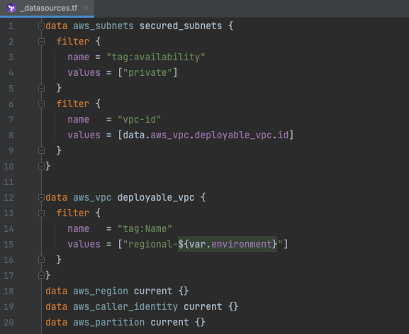
Data Sources…
Notes:
Sometimes, you need to reference a resource that already exists in your deployment environment. Many resources will also have a datasource concept where you can pass in some sort of a filter to obtain the details on the resource.
This comes in very handy when your environment has specific standards. In this deployment, I created a vpc that has a specific naming convention, and I need to obtain the subnets that are in that. By using a data source to obtain this information, I don’t have to specify them as variables, instead I use the naming conventions.
What I have shown above, starting on line 12, recognizes that my deployable VPC has a tag called Name, and the value starts with ‘regional-dash’ and ends with the deployment environment. Since I’ve set that variable in the configuration, regardless of which environment I deploy this in dev test or prod, I can obtain the information on that vpc, especially the id.
I then can use that id in determining which subnets within that vpc I need to use. Those subnets have a tag called availability with a value of private.
Near the bottom, you you see that I have three other data sources getting information on the region, caller-identity, and partion. The region is also set via the variable, but the caller-identity will allow me to obtain the account number. This is necessary when I build AWS IAM policies, to ensure the access is limited to this account. The partition is used if I am deploying to AWS commercial cloud space or to their gov-cloud space. By setting this data source in this manner, this terraform script can be deployed to either commercial or gov-cloud merely by changing the login-credentials.

Slide 20
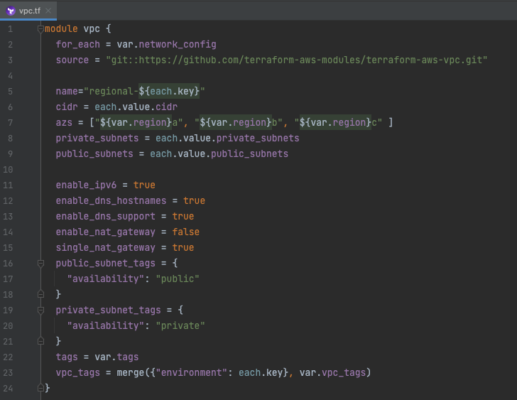
Third Party Libraries…
Notes:
Often times you’ll find that you are re-using an entire set of resources multiple times.
One example of this is building out your aurora database, or your network infrastructure.
All of the pieces that we’ve deployed for this aurora database cluster, from the KMS keys, to the subnet groups, to the security groups can be easily reused by packing this into a module. Although not in this particular module, if your organization has required AWS Alarms for your RDS resources, you can build those into your modules to ensure that they’re always configured based on your internal requirements.
Modules allow us to create a customized deployment that can be re-used, much like any other third-party library, or even in-house library, that you might use in development.
An example here is a module for VPC. This takes a source file, in this case a git-repo managed by hashicorp.
This module calculates subnets, creates a vpc, default routing tables, subnet groups, cidr-block associations (which are required for routing), internet gateways, nacls and potentially 10’s of different resources that you might otherwise program in manually in your deployment. But by using this module, we don’t have to try to remember all of the bits and baubles that are required to make a usable cloud networking space. In this particular case, this single module created 85 different resources.

Slide 21
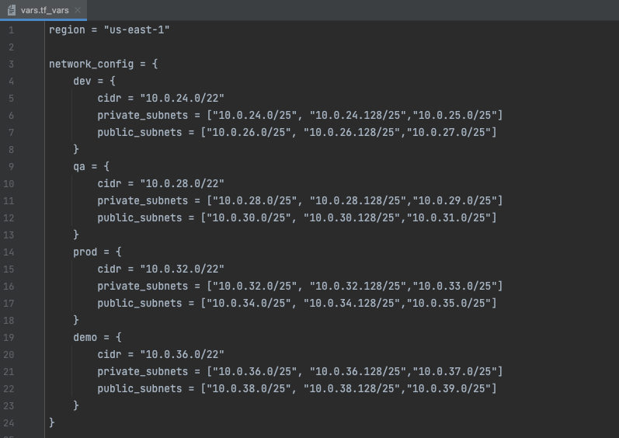
Third Party Libraries…
Notes:
Also notice at the top of this module implementation, that I have a for_each line.
When I created my variables, I have a map of objects that define my network configurations.
This will loop through my network_config variable and deploy, in this case, four different network configurations into this region. One for dev, demo, qa and production. Each has different CIDR ranges for the VPC and each has two sets of three subnets. Each subnet will be deployed into one of the listed Availability Zones.
We can create custom modules for our organization, and save them in git repos, or we can use open-source modules. This allows us to pre-bake specific rules into modules.
One custom module that I’ve worked on was for AWS Elasticache. There are specific compliance programs that a client requires, and of those, only Elasticache Redis hits those markers. For that reason, the module was hard-coded to use Redis, and memcached would require anyone implementing it to go through and rebuild all of the resources themselves… Capturing that information in the documentation is important, though, to ensure that people don’t fork a repo to rebuild it with non-compliant resources.
Modules can be sourced from the terraform registry, from source control repos, s3 buckets and GCP buckets, as well as packaged in sub-directories.
By packaging a module within a sub-directory is allows us to reuse a very specific resource build within our deployment. This can be used to handle specific use-cases within our deployment, such as EC2 instances that are ‘flavored’ for our deployment with networking, security groups and the like, but that might not fit a wider use case that also used EC2 instances.

Slide 22
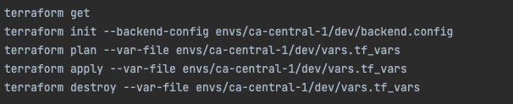
Building, making and deploying a Terraform script…
Notes:
Building and ‘making’ a terraform script for deployment is easily done via the command line, assuming that you’ve installed it and that you can connect to your cloud of choice.
A few commands we need to know are GET, INIT, PLAN, APPLY, DESTROY.
Terraform get is specifically used to download your module sources. This is especially helpful if using any sort of code-completion in an IDE, as it helps confirm parameters that must be passed in when you call the resource constructor.
Terraform init will also do this, but it also initializes your backend configuration, ensures that all of your required libraries are correct and that locking is configured

Slide 23
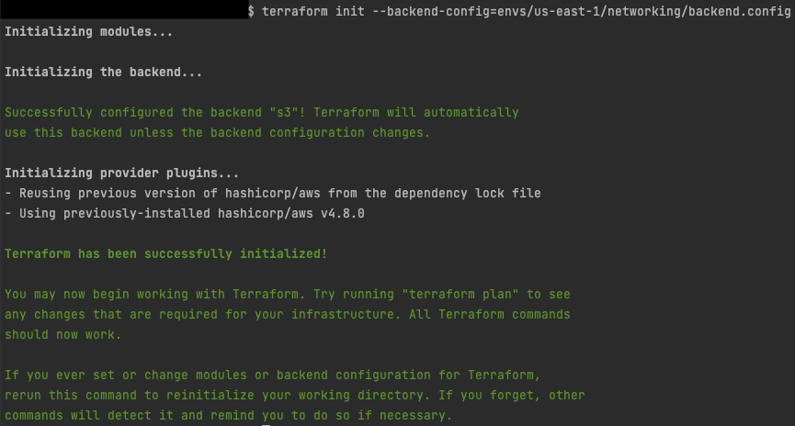
Building, making and deploying a Terraform script…
Notes:
Building and ‘making’ a terraform script for deployment is easily done via the command line, assuming that you’ve installed it and that you can connect to your cloud of choice.
A few commands we need to know are GET, INIT, PLAN, APPLY, DESTROY.
Terraform get is specifically used to download your module sources. This is especially helpful if using any sort of code-completion in an IDE, as it helps confirm parameters that must be passed in when you call the resource constructor.
Terraform init will also do this, but it also initializes your backend configuration, ensures that all of your required libraries are correct and that locking is configured. Notice that when I call init here, I specify the file that has my backend configuration.
Terraform plan will generate an execution plan. It tells what resources need to be created, what need to be destroyed, and what need to be changed. Some attributes of a resource can be updated in place, while others cannot. For instance, if you change the tags on resources, those can be updated in place, but other resources may cause a resource to be destroyed and recreated.
Terraform apply will start by doing a Terraform plan, but will then ask if you want to apply those changes. Typing yes will work through all of the changes that the plan shows.
Terraform destroy will also start with a plan. It will show you all of the resources that your plan created, and prompt you as to whether or not you want to destroy them all. It will then cycle through all of the resources and destroy them.

Slide 24
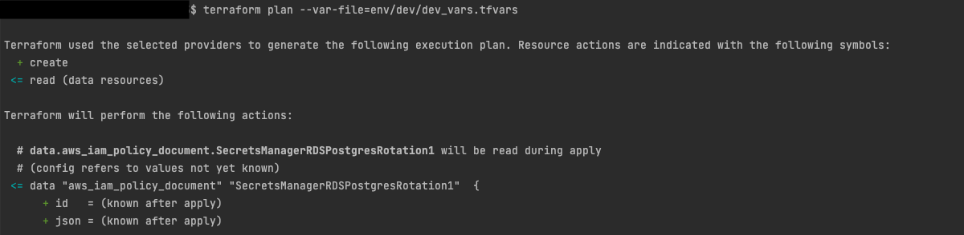
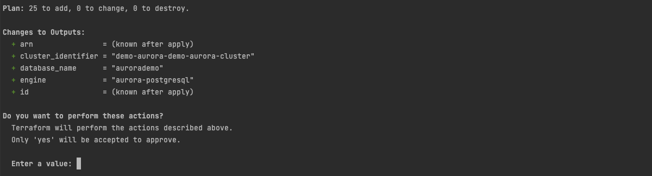
Building, making and deploying a Terraform script…
<< text removed >>
Notes:
Building and ‘making’ a terraform script for deployment is easily done via the command line, assuming that you’ve installed it and that you can connect to your cloud of choice.
A few commands we need to know are GET, INIT, PLAN, APPLY, DESTROY.
Terraform get is specifically used to download your module sources. This is especially helpful if using any sort of code-completion in an IDE, as it helps confirm parameters that must be passed in when you call the resource constructor.
Terraform init will also do this, but it also initializes your backend configuration, ensures that all of your required libraries are correct and that locking is configured. Notice that when I call init here, I specify the file that has my backend configuration.
Terraform plan will generate an execution plan. It tells what resources need to be created, what need to be destroyed, and what need to be changed. Some attributes of a resource can be updated in place, while others cannot. For instance, if you change the tags on resources, those can be updated in place, but other resources may cause a resource to be destroyed and recreated.
Terraform apply will start by doing a Terraform plan, but will then ask if you want to apply those changes. Typing yes will work through all of the changes that the plan shows.
Terraform destroy will also start with a plan. It will show you all of the resources that your plan created, and prompt you as to whether or not you want to destroy them all. It will then cycle through all of the resources and destroy them.

Slide 25
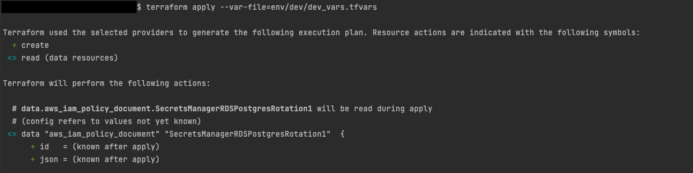
Building, making and deploying a Terraform script…
<< text removed >>
Notes:
Building and ‘making’ a terraform script for deployment is easily done via the command line, assuming that you’ve installed it and that you can connect to your cloud of choice.
A few commands we need to know are GET, INIT, PLAN, APPLY, DESTROY.
Terraform get is specifically used to download your module sources. This is especially helpful if using any sort of code-completion in an IDE, as it helps confirm parameters that must be passed in when you call the resource constructor.
Terraform init will also do this, but it also initializes your backend configuration, ensures that all of your required libraries are correct and that locking is configured. Notice that when I call init here, I specify the file that has my backend configuration.
Terraform plan will generate an execution plan. It tells what resources need to be created, what need to be destroyed, and what need to be changed. Some attributes of a resource can be updated in place, while others cannot. For instance, if you change the tags on resources, those can be updated in place, but other resources may cause a resource to be destroyed and recreated.
Terraform apply will start by doing a Terraform plan, but will then ask if you want to apply those changes. Typing yes will work through all of the changes that the plan shows.
Terraform destroy will also start with a plan. It will show you all of the resources that your plan created, and prompt you as to whether or not you want to destroy them all. It will then cycle through all of the resources and destroy them.

Slide 26
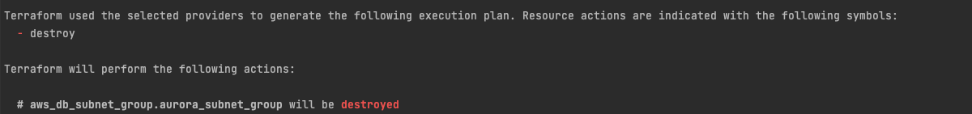
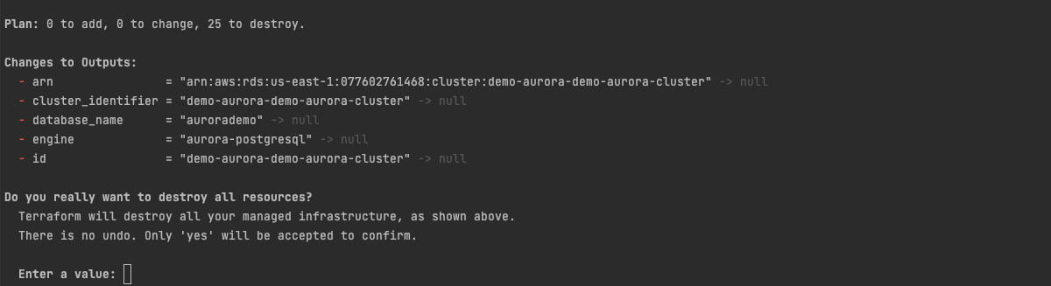
Building, making and deploying a Terraform script…
<< text removed >>
Notes:
Building and ‘making’ a terraform script for deployment is easily done via the command line, assuming that you’ve installed it and that you can connect to your cloud of choice.
A few commands we need to know are GET, INIT, PLAN, APPLY, DESTROY.
Terraform get is specifically used to download your module sources. This is especially helpful if using any sort of code-completion in an IDE, as it helps confirm parameters that must be passed in when you call the resource constructor.
Terraform init will also do this, but it also initializes your backend configuration, ensures that all of your required libraries are correct and that locking is configured. Notice that when I call init here, I specify the file that has my backend configuration.
Terraform plan will generate an execution plan. It tells what resources need to be created, what need to be destroyed, and what need to be changed. Some attributes of a resource can be updated in place, while others cannot. For instance, if you change the tags on resources, those can be updated in place, but other resources may cause a resource to be destroyed and recreated.
Terraform apply will start by doing a Terraform plan, but will then ask if you want to apply those changes. Typing yes will work through all of the changes that the plan shows. Apply may take a while, but it will usually show you progress in about 10-second intervals.
Terraform destroy will also start with a plan. It will show you all of the resources that your plan created, and prompt you as to whether or not you want to destroy them all. It will then cycle through all of the resources and destroy them.

